Slide 1





High Cloud Airlines
Data Analysis & Optimization
Presented By:
P798 - Group 1

Slide 2

Importance of Data Analytics
Data analytics enables airlines to identify trends, forecast demand, and streamline operations.
By harnessing data, High Cloud Airlines enhances decision-making capabilities and improves operational efficiency, which is essential for maintaining competitive advantage.

Slide 3

OVERVIEW OF AIRLINE INDUSTRY
The airline industry is a complex and dynamic sector, characterized by intense competition, regulatory constraints, and fluctuating demand. Data analytics plays a critical role in optimizing operations and enhancing customer experience, driving with in a competitive market.

Slide 4

Project Overview
In today’s competitive airline industry, data analysis plays a crucial role in optimizing operations and maximizing profitability.
Objectives:
Improve load factor
Enhance passenger experience
Optimize resource allocation
Data-driven decision-making

Slide 5

Methodology
Analyzing SQL, Excel, Tableau, and Power BI Impact on High Cloud Airlines
Steps Followed:
Data Cleaning & Preprocessing
Data Exploration & Merging
KPI Analysis
Data Visualization & Dashboard Creation

Slide 6

Data Exploration & Cleaning
Challenges & Actions Taken
Handled missing and duplicate values.
Treated all data quality issues.
Standardized and formatted data for accurate analysis.

Slide 7

Data Modeling
Challenges Faced
Managing & processing large datasets efficiently.
Ensuring data accuracy & reliability.

Slide 8

Data Visualization Needs in Aviation
Key needs include analyzing flight schedules, passenger trends, and route efficiency while monitoring financial performance and regulatory adherence.
Effective visualization tools such as Power BI and Tableau, along with data analysis in Excel and SQL, help airlines make data-driven decisions to improve efficiency and profitability.

Slide 9
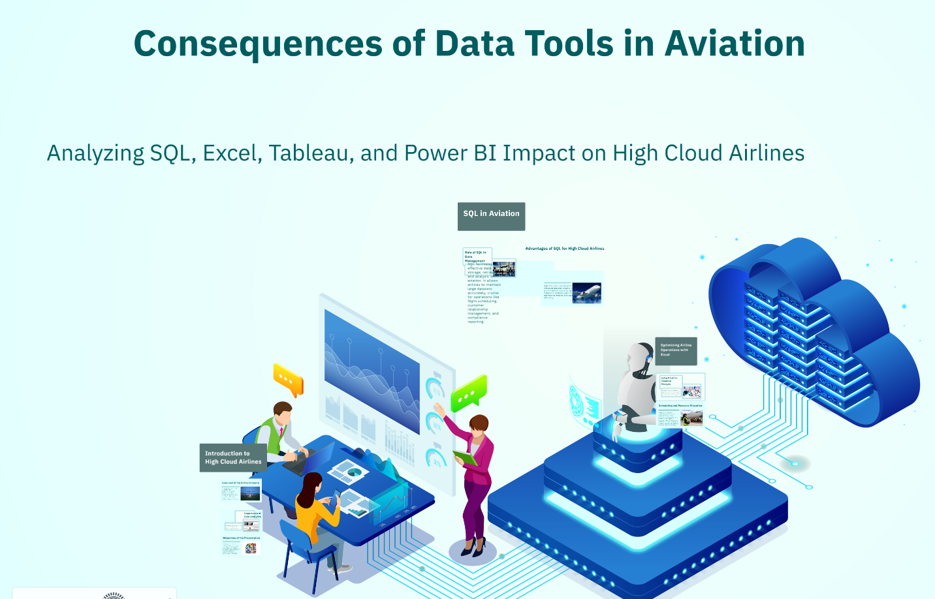

Slide 10
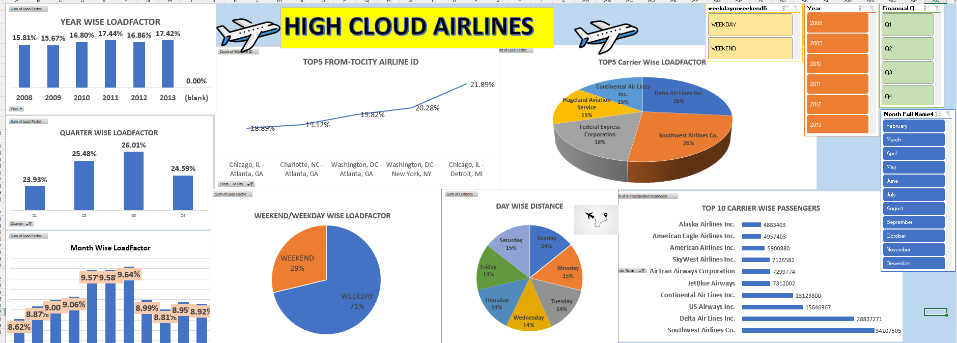
Dashboard of Excel for High Cloud Airlines
Excel remains a fundamental tool for aviation analytics with its versatile data processing and visualization features:
Pivot Tables & Charts: Helps summarize and analyze large airline datasets efficiently.
Formula-Based Calculations: Enables custom calculations for performance metrics, revenue tracking, and cost analysis.
Data Modeling with Power Query: Facilitates data transformation and automation for airline reports.
Conditional Formatting: Highlights key trends and anomalies in aviation data.

Slide 11
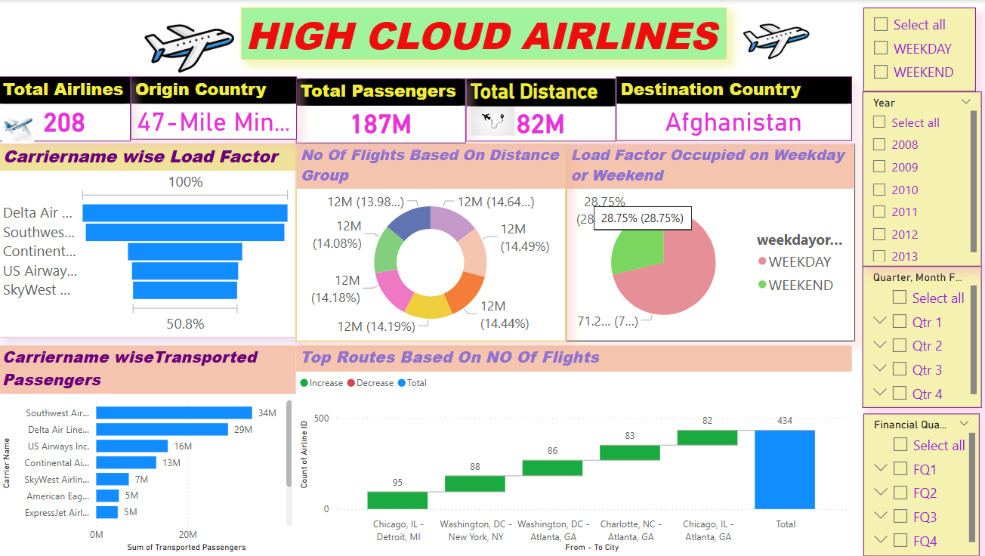
Dashboard Of Power BI for High Cloud Airlines
Power BI provides advanced Business Intelligence Solutions that enable High Cloud Airlines to make data-driven decisions.
Interactive Dashboards: Users can drill down into specific data points, apply filters, and gain detailed insights.
Real-Time Analytics: Ability to connect to live data sources and monitor key metrics in real-time.
Customizable Visuals: Provides bar charts, pie charts, maps, and other visualizations to present data effectively.
Security & Data Governance: Provides role-based access control, ensuring secure data management for aviation insights.

Slide 12
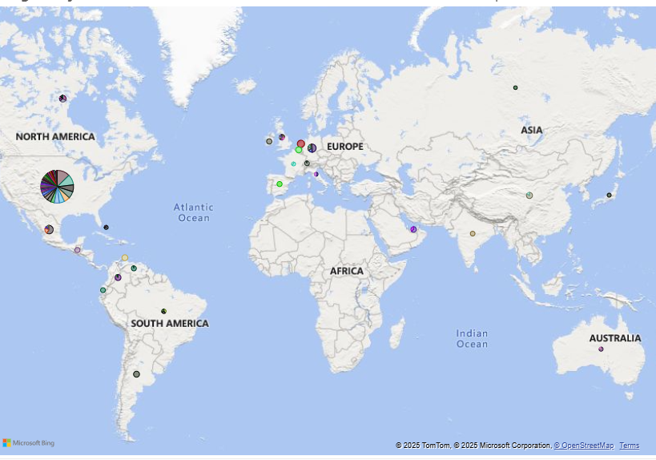
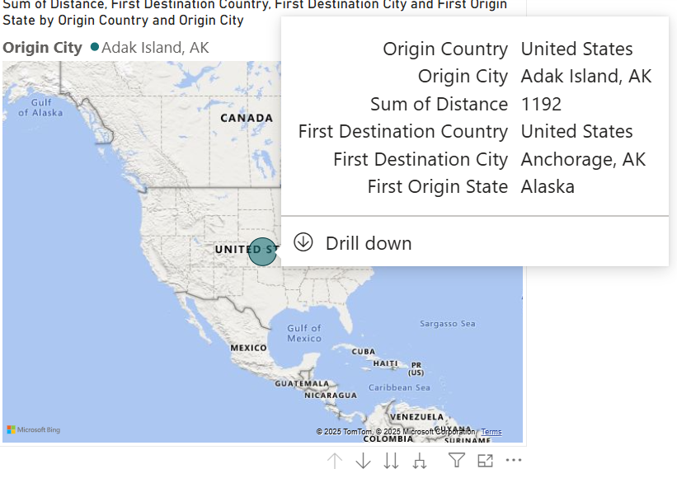
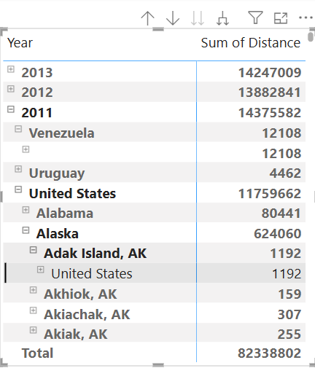
We can use the filter to provide a search capability to find the flights between Source Country, Source State, Source City to Destination Country , Destination State, Destination City

Slide 13
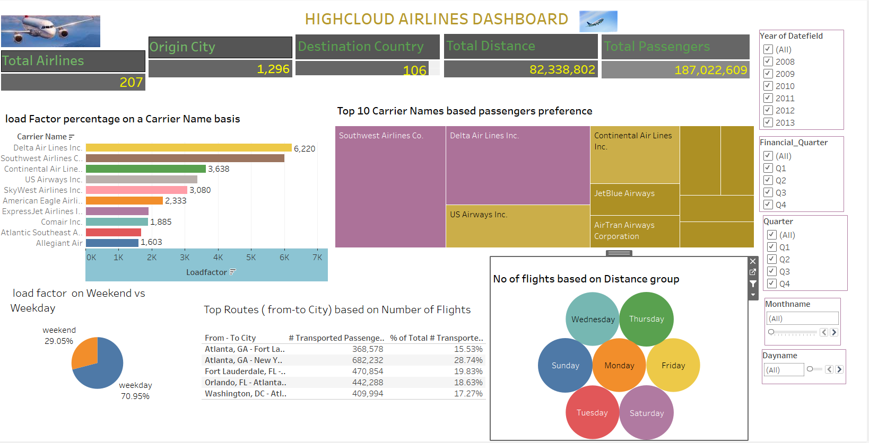
Dashboard of Tableau for High Cloud Airlines
Tableau offers powerful data visualization capabilities specifically suited for aviation analytics.
Drag-and-Drop Visualization: Allows users to create interactive dashboards without coding expertise.
Advanced Analytics: Supports trend analysis, forecasting, and complex calculations for deep insights.
Real-Time Data Connection: Connects to multiple live data sources, ensuring up-to-date reporting.
Cross-Platform Compatibility: Works on desktop, web, and mobile for flexible access to reports.

Slide 14
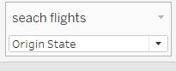
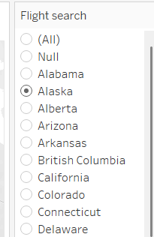
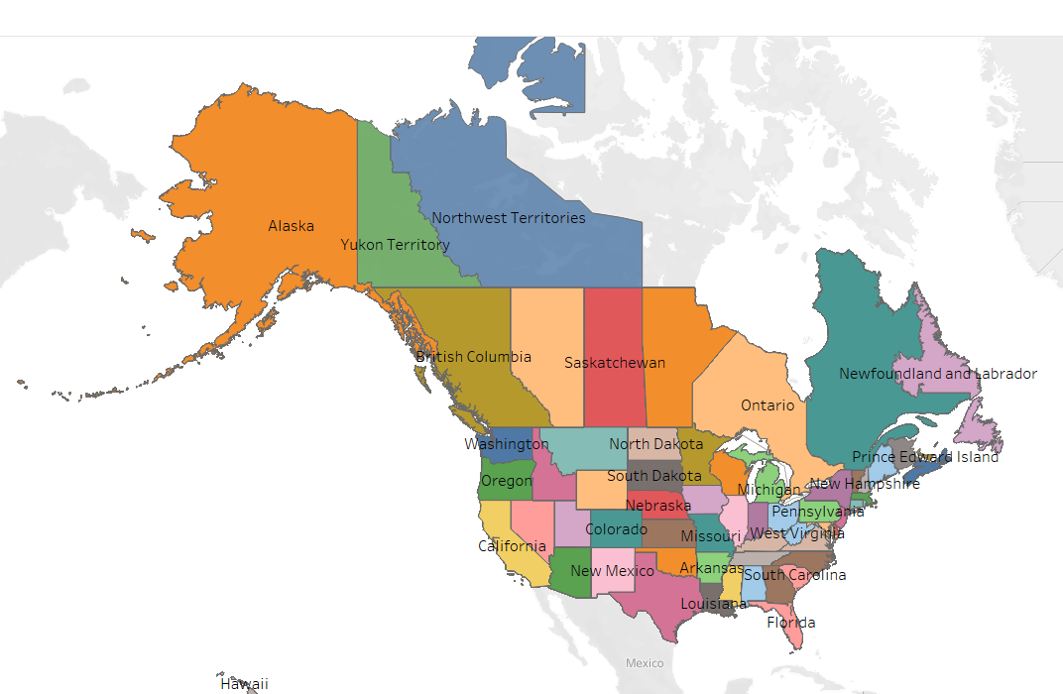
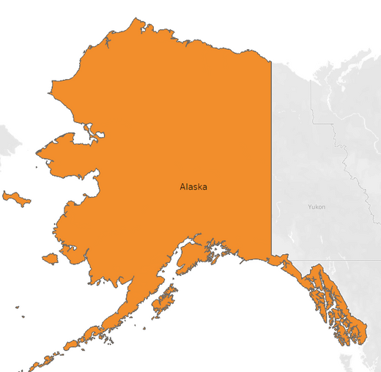
We can use the filter to provide a search capability to find the flights between Source Country, Source State, Source City to Destination Country , Destination State, Destination City
Geospatial Mapping: Built-in maps help analyze flight routes, airport locations, and passenger distribution effectively.

Slide 15
SQL in Aviation
Role of SQL in Data Management
SQL facilitates effective data storage, retrieval, and analysis in aviation.
It allows airlines to maintain large datasets accurately, crucial for operations like flight scheduling, customer relationship management, and compliance .
Advantages of SQL for High Cloud Airlines
High Cloud Airlines benefits from SQL through improved decision-making, faster data processing, and enhanced reporting capabilities.
SQL integration enables real-time insights into operational metrics and customer data, driving efficiency.

Slide 16

Key Performance Indicators (KPIs)
Load Factor Analysis:
Yearly, Quarterly, Monthly Basis
Carrier Name Basis
Passenger Preferences:
Top 10 Carrier Names by preference
Flight Route Optimization:
Top Routes by Flight Count
Weekend vs. Weekday Analysis:
Load Factor Distribution
Distance Group Analysis:
Number of Flights by Distance

Slide 17
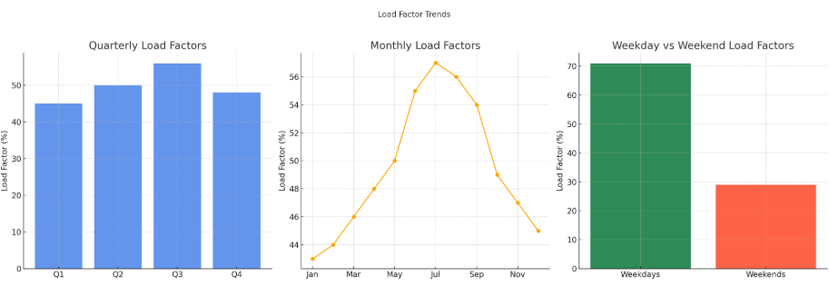
Market Analysis & Insights
Objective: Optimize High Cloud Airlines' operations through data analysis.
Load Factor Trends- Key Findings:
Peak load factors were identified in Q3 (56%) and specifically in July (57%).
Weekday load factors (71%) are significantly higher than weekend load factors (29%).

Slide 18
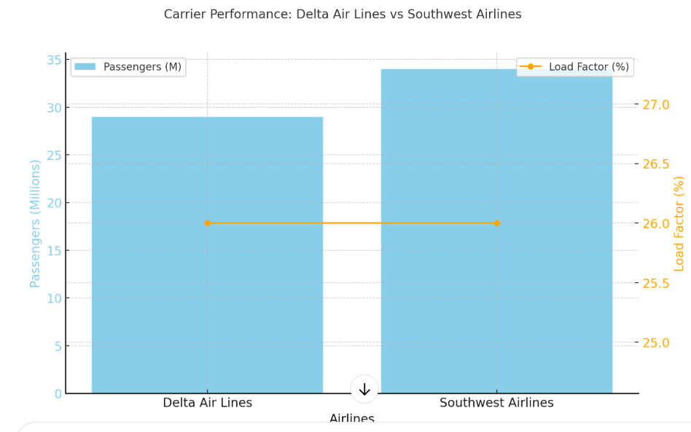
Carrier Performance- Key Findings:
Delta Air Lines Inc. and Southwest Airlines Co. have the highest load factors at 26%.
Southwest Airlines transported the most passengers (34M) compared to Delta Air Lines (29M).

Slide 19
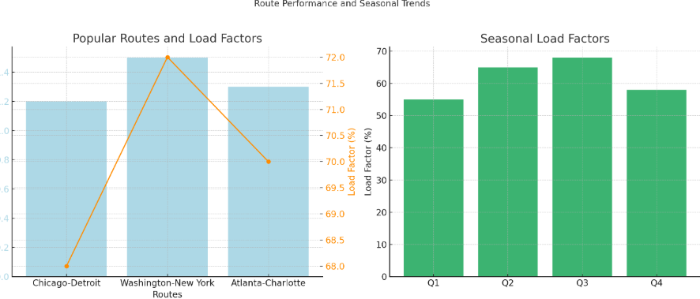
Route Performance key Findings:
Popular routes include Chicago to Detroit, Washington to New York, and Atlanta to Charlotte.
Q2 and Q3 recorded the highest load factors, indicating seasonal demand spikes.

Slide 20
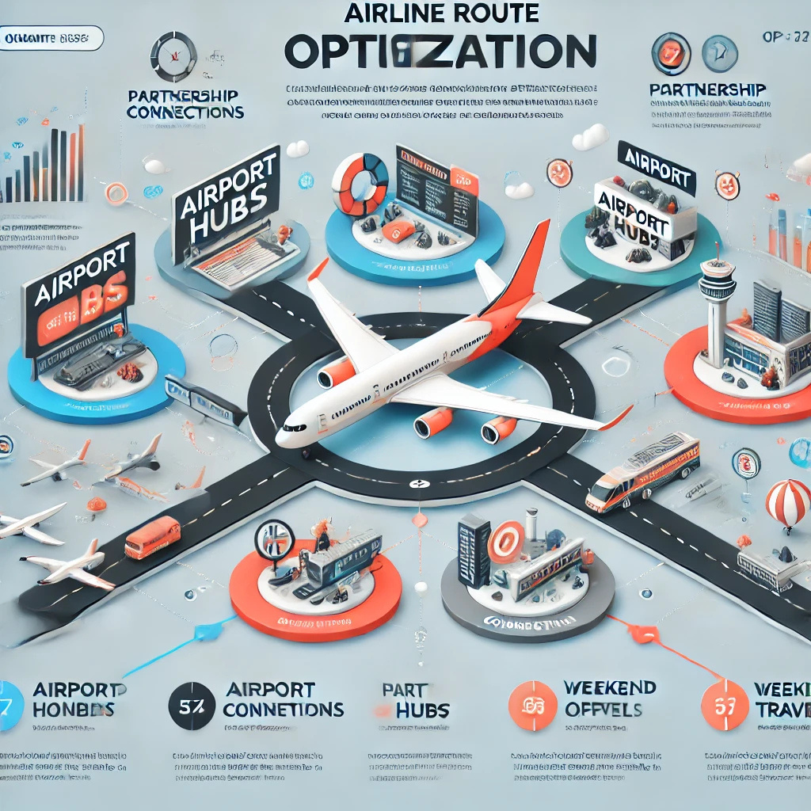
Recommended Route Optimization Strategies
Increase Capacity During Peak Periods:
Allocate additional flights in Q3, especially in July, to maximize revenue.
Expand High-Demand Routes:
Focus on strengthening top-performing routes like Chicago to Detroit and Washington to New York.
Leverage Strategic Partnerships:
Form alliances with top carriers to provide seamless connectivity and expand market reach.
Promotional Campaigns:
Offer promotions during off-peak periods to boost passenger numbers and optimize resource utilization.
Optimize Weekend Operations:
Introduce attractive weekend pricing and targeted marketing to balance the load factor more evenly.

Slide 21
Best Tool for Aviation Data Needs
Power BI – Best for real-time dashboards on flight operations, revenue, and fuel efficiency.
Tableau – Best for deep insights into aviation trends, passenger analysis, and route optimization.
Excel – Best for quick data summaries, cost calculations, and operational reports.
SQL – Best for storing and processing airline data before using visualization tools.

Slide 22
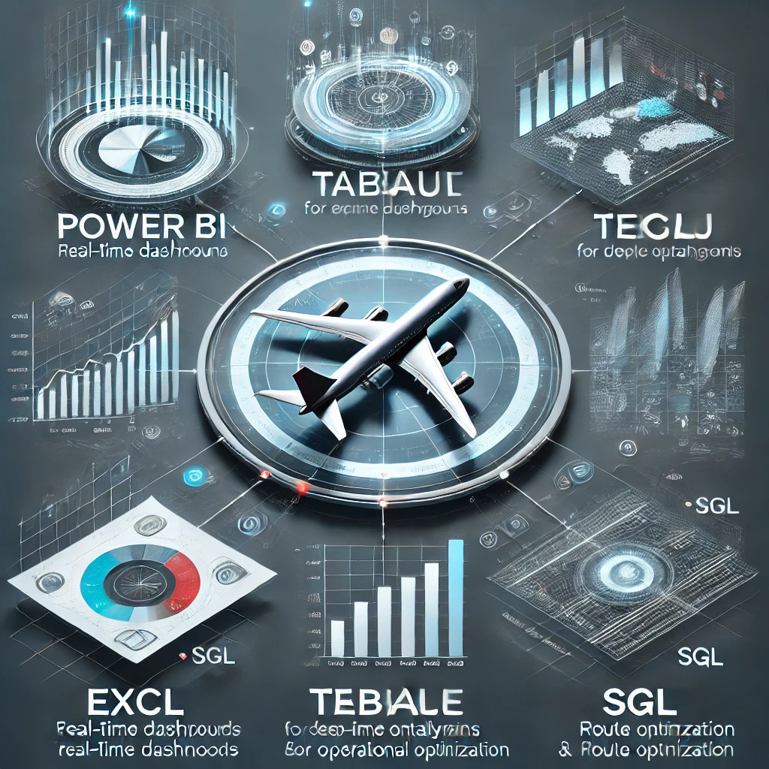
Final Dashboard and Summary
High Cloud Airlines can boost performance by increasing flight capacity during peak periods, expanding popular routes, and forming strategic partnerships.
Targeted promotions and optimized weekend pricing will help balance load factors.
Real-time dashboards will support continuous monitoring and data-driven decisions.

Slide 23


